Slide 1
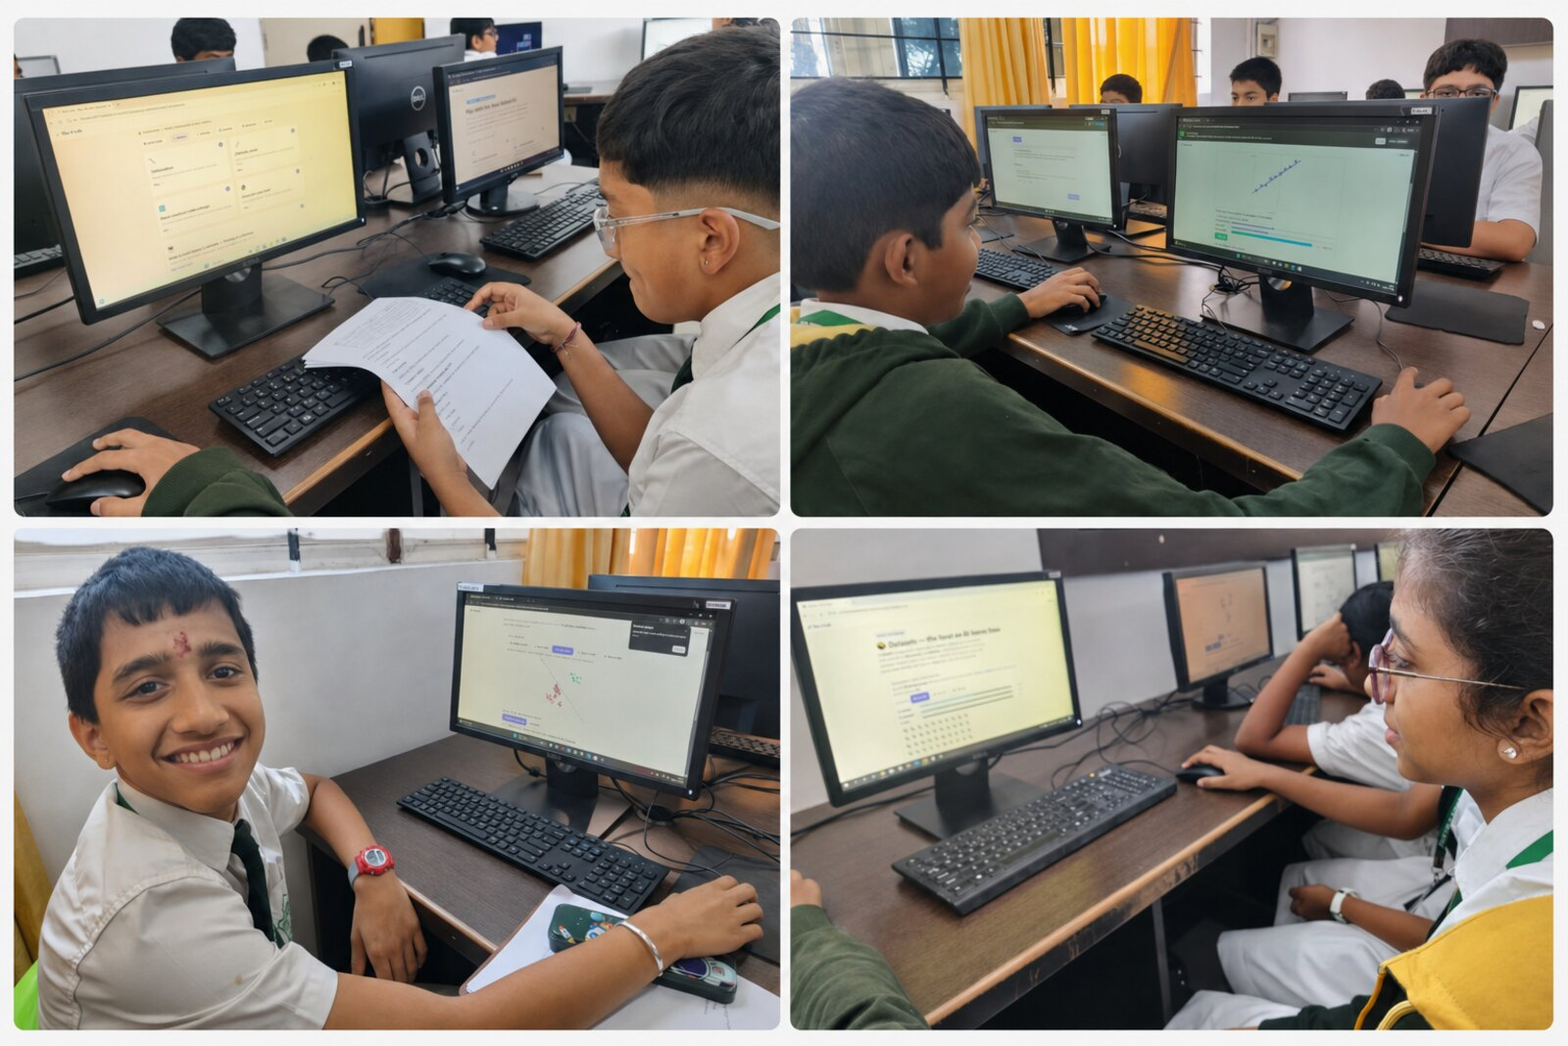
● DISTRICT LEVEL DELIBERATIONS · CT & AI 2026–27 · THEME 2
From Play to Abstraction
Children in Grades 3–8 can truly understand AI — Machine Learning, neural networks, compression, even language models — when we start from how they already think.
“AI is not magic. It learns from examples.”
Real Class 6–8 students using the AI Lab
A low-cost, no-coding classroom approach — built, taught and measured in real Grades 6–8.
From Play to Abstraction · Case study for District Level Deliberations on CT & AI 2026–27
01 / 10
Notes:
[~25s] Open on the promise. For 2026-27 CT & AI is a district priority. Our claim, up front: children can genuinely understand AI — not as magic, but as something that learns from examples — if we start from how they already think. We built it, taught it in real classrooms, and measured it. Here's the story.

Slide 2
THE STARTING POINT
Every child already thinks like a learning machine.
A child recognises a friend's face from half a glimpse, sorts their toys in seconds, and finishes a sentence before it is spoken. Recognising, sorting, predicting from examples — that is exactly what AI does.
They recognise
They sort
They predict
Spot a friend, a song, a fruit's smell — from just a few clues, matched against everything seen before.
Group animals, fruits, shapes — then re-group the very same things a different way.
“The sun rises in the ___.” Filled instantly — from context and past experience.
Meanwhile, AI is now woven through their daily life — search, video feeds, voice assistants, photos. The readiness is already there.
From Play to Abstraction · Case study for District Level Deliberations on CT & AI 2026–27
02 / 10
Notes:
[~45s] Set the stable ground everyone agrees on. Children are not blank slates for AI — they already recognise, sort and predict from examples every day. And AI already surrounds them. So the raw readiness is there. Hold this thought — it's what we build on.

Slide 3
THE GAP
Yet children meet AI only as finished magic — they see the output, never the thinking.
So AI feels…
AND THE USUAL FIXES MAKE IT WORSE
Magical
Opening with “ML is a subset of AI”, or jumping to code and formulas, turns a familiar idea into an abstract, intimidating one.
“It just knows the answer.”
Mysterious
And it shuts out low-resource classrooms — those without devices, labs or a coding teacher — the very ones we most need to reach.
“No one can explain how.”
Mechanical
“A robot that memorised everything.”
So the question: How do we make AI genuinely understandable — cheaply, without code, for every child in Grades 3–8?
From Play to Abstraction · Case study for District Level Deliberations on CT & AI 2026–27
03 / 10
Notes:
[~55s] Here's the tension. Children see AI's output but never its thinking — so it reads as magic, mystery, or a know-it-all robot. And our instinct as educators makes it worse: we lead with definitions or code, which abstracts a familiar idea and excludes the classrooms with no devices or coding teacher. That frames the real question at the bottom — understandable, cheap, no code, all of Grades 3-8.

Slide 4
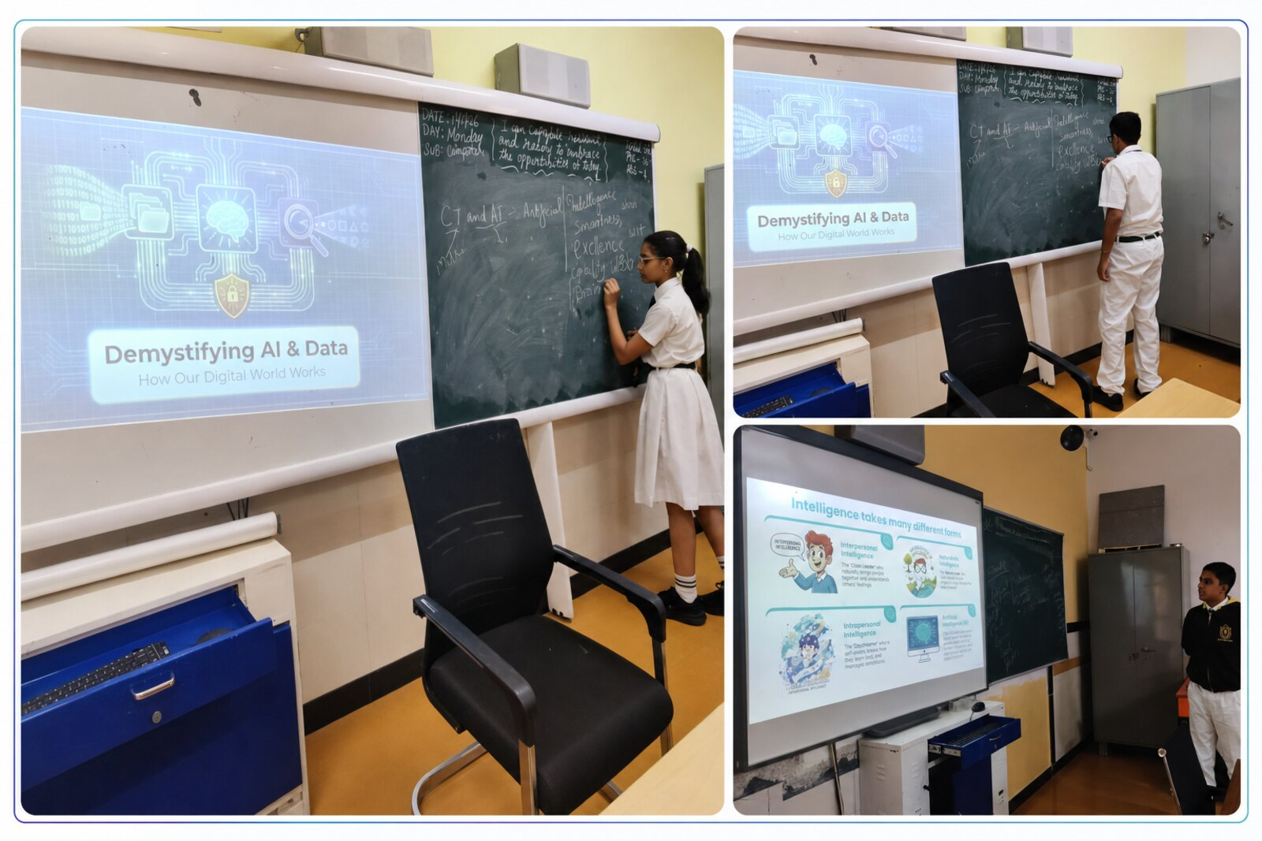
THE IDEA
So begin with the child's own play — and let the abstraction come after, never before.
Don't open with a definition. Open with “How do you recognise your friend's face?” The child plays first, describes what they did, watches the machine mirror it — then we name the idea.
ONE THREAD RUNS THROUGH EVERYTHING
Observe examples
→
Find useful patterns
→
Compress to what matters
→
Predict / classify / generate
The same thread carries a child from a playground guessing-game all the way to a Large Language Model — pixels, sounds and words, all learned from examples.
Students explaining the ideas behind AI & data in their own words
From Play to Abstraction · Case study for District Level Deliberations on CT & AI 2026–27
04 / 10
Notes:
[~60s] This is the answer — the pivot of the whole talk. Flip the order: play first, name the idea after. Ask 'how do you recognise your friend's face', not 'what is machine learning'. And one single thread ties it all together — observe, find patterns, compress, predict — the same thread from a playground game to a language model. Everything after this is how we delivered it and the proof that it works.

Slide 5
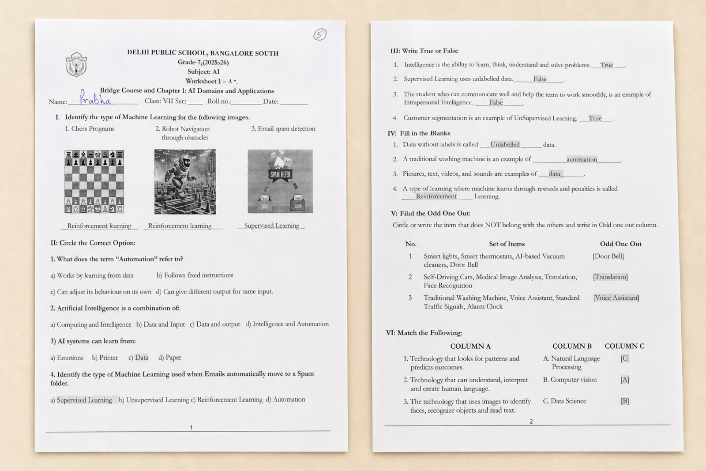
WHAT WE BUILT
We turned that idea into a hands-on AI Lab — a website and paper worksheets, with no coding required.
A live AI Lab
Paper worksheets
Question banks
Runs offline
6 connected modules · 8 activities children play in the browser. Each shows a “You ↔ the Machine” panel: the child does it, then the computer does the very same thing.
The same activities run on paper — sorting cards, pixel-art on graph paper, predict-the-word. Low-cost and inclusive.
155 objective questions across Classes 6–8 — five per activity, with answer keys, ready to print.
A downloadable pack runs with no internet at all — built for classrooms with little or no connectivity.
No coding. No lab required. No formulas. Just curiosity, everyday objects and paper.
Live now: play-to-abstraction.pages.dev · nlp-lab.pages.dev
From Play to Abstraction · Case study for District Level Deliberations on CT & AI 2026–27
05 / 10
Notes:
[~55s] So we built it. A live AI Lab website — six modules, eight activities, each pairing the child's action with the machine doing the same thing. The identical activities work on plain paper. Print-ready question banks for Classes 6 to 8. And the whole thing runs offline. The design principle throughout: no code, no lab, no formulas — so any classroom can run it.

Slide 6
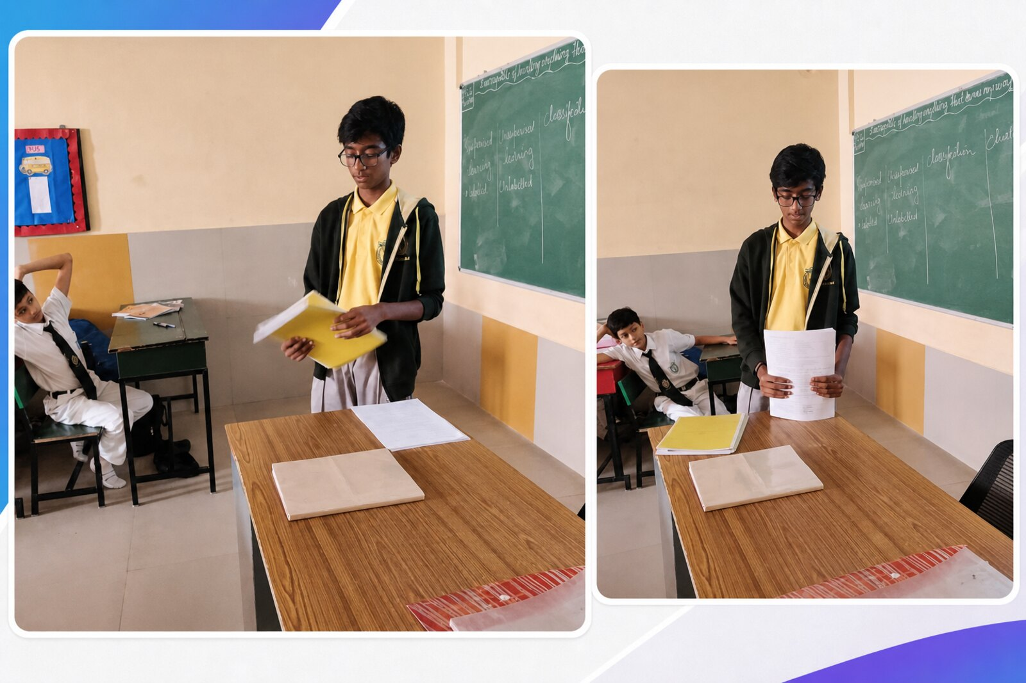
IN THE CLASSROOM
We didn't just design it — we ran it with real Grades 6–8 students.
WHAT IT LOOKED LIKE
On screens
Children playing the live activities in the computer lab.
On paper
Worksheets and printed exercises at every desk.
At the board
Students presenting AI ideas — in their own words.
Every learner
Engaged — not watching a demo, but doing it.
From Play to Abstraction · Case study for District Level Deliberations on CT & AI 2026–27
06 / 10
Notes:
[~40s] And crucially, this is real — not a mock-up. Students in the computer lab playing the activities, worksheets on every desk, children up at the board explaining supervised versus unsupervised learning in their own words. The room isn't watching a demo; every child is doing it. Which sets up the honest question any decision-maker asks next: did it actually work?

Slide 7
PUTTING IT TO THE TEST
So we measured it honestly — three Class-8 sections, the same test before and after.
120 students, three weeks. The same 20-mark test — answered in the child's own words, no coding — given before and after, so each section is its own fair comparison.
A
Not taught
B
Taught with the computer
C
Taught with the activities
The comparison group — carried on as usual.
Led through the ideas on screen.
The full hands-on, play-first approach.
40 students
40 students
40 students
“Understood it well” is defined up front as scoring 12 or more out of 20.
From Play to Abstraction · Case study for District Level Deliberations on CT & AI 2026–27
07 / 10
Notes:
[~50s] So we tested it, and tested it fairly. Three Class-8 sections, 40 students each, three weeks. The same 20-mark plain-language test before and after — so every group is measured against its own starting point. Section A carried on as usual, B was taught on the computer, C got the full hands-on activities. We set the bar in advance: 12 out of 20 means the child genuinely understood it.

Slide 8
THE EVIDENCE
Hands-on learning matched the computer — and both left “no teaching” far behind.
Average score (out of 20)
+4.6
WHAT THE NUMBERS SAY
15
+4.4
13.8
12.8
Activities +4.6 ≈ computer +4.4
— and both roughly 3× the +1.5 with no teaching.
+1.5
10.2
10
8.7
9.2
8.4
Understood it well (12+/20, of 40)
5
Activities
30 / 40
Computer
25 / 40
Not taught
13 / 40
Section A
Section B
Section C
not taught
computer
activities
The takeaway: you do not need a computer for every child — a low-cost, paper-friendly, activity-led class delivers the same jump.
before
after
From Play to Abstraction · Case study for District Level Deliberations on CT & AI 2026–27
08 / 10
Notes:
[~65s] Here's the payoff. Every section started level, around 8-9 out of 20. After three weeks: no-teaching crept up 1.5 — just test familiarity. The computer group jumped 4.4. And the hands-on activities group jumped 4.6 — matching the computer. On the 'understood it well' bar, 30 of 40 activity students cleared it, versus 25 for computer and 13 for none. The decision-maker's takeaway is on the right: you don't need a device for every child to get the same result — which is exactly what makes this scalable.

Slide 9
WHY IT WORKS
Because every abstract idea is something the child physically did first.
The approach builds a connected set of Computational-Thinking and AI-readiness competencies — and each one is grounded in an activity the child has actually done, not a definition they were told.
Pattern recognition
Decomposition
Abstraction
Classification
guessing from partial clues
breaking a thing into features
keeping only what matters
sorting new examples by learned rules
Training & testing
Generalisation
Representation & compression
Responsible AI
learn from examples, then apply
working on unseen cases, not memorising
pixels & 0/1, keep the gist
AI can be wrong — check it
From Play to Abstraction · Case study for District Level Deliberations on CT & AI 2026–27
09 / 10
Notes:
[~45s] Why does a paper class match a computer? Because none of this is delivered as a definition. Every competency here — pattern recognition, abstraction, classification, generalisation, responsible AI — is first something the child physically did: sorted cards, drew pixel-art, trained a friend, corrected a mistake. Understanding sticks because it was built by hand before it was named.

Slide 10
THE SHIFT
From “AI is a robot that knows everything” → “AI learns from examples — and can be wrong.”
A low-cost, no-coding, activity-led approach gave Grades 6–8 a genuine grasp of AI — and the evidence says it scales.
WHAT WE PROPOSE NEXT
Adopt across the district
SEE IT · TRY IT
Run it in Grades 3–8 — starting where devices are scarce.
The AI Lab (6 modules, 8 live activities)
play-to-abstraction.pages.dev
Per-class labs + question banks
nlp-lab.pages.dev
Runs fully offline — download the pack, no internet needed.
A short teacher orientation
One session; the activities are paper-simple and self-guided.
Repeat the pilot with pre/post tests
Same 20-mark test — make the impact visible everywhere.
From Play to Abstraction · Case study for District Level Deliberations on CT & AI 2026–27
10 / 10
Notes:
[~40s] Close on the shift we set out to make: from AI-as-magic-robot to AI-as-something-that-learns-and-can-be-wrong. We showed children can get there, cheaply, without code — and the numbers say it scales. Three asks: adopt across the district starting where devices are scarce; a single short teacher orientation; and repeat the pre/post test so the impact is visible everywhere. Everything is live and offline-ready at these links. Thank you.

